Slide 1
Ports Programming
Embedded Systems: Using Assembly and C
Dept. of Software Engineering
Bahria University, Karachi Campus

Slide 2
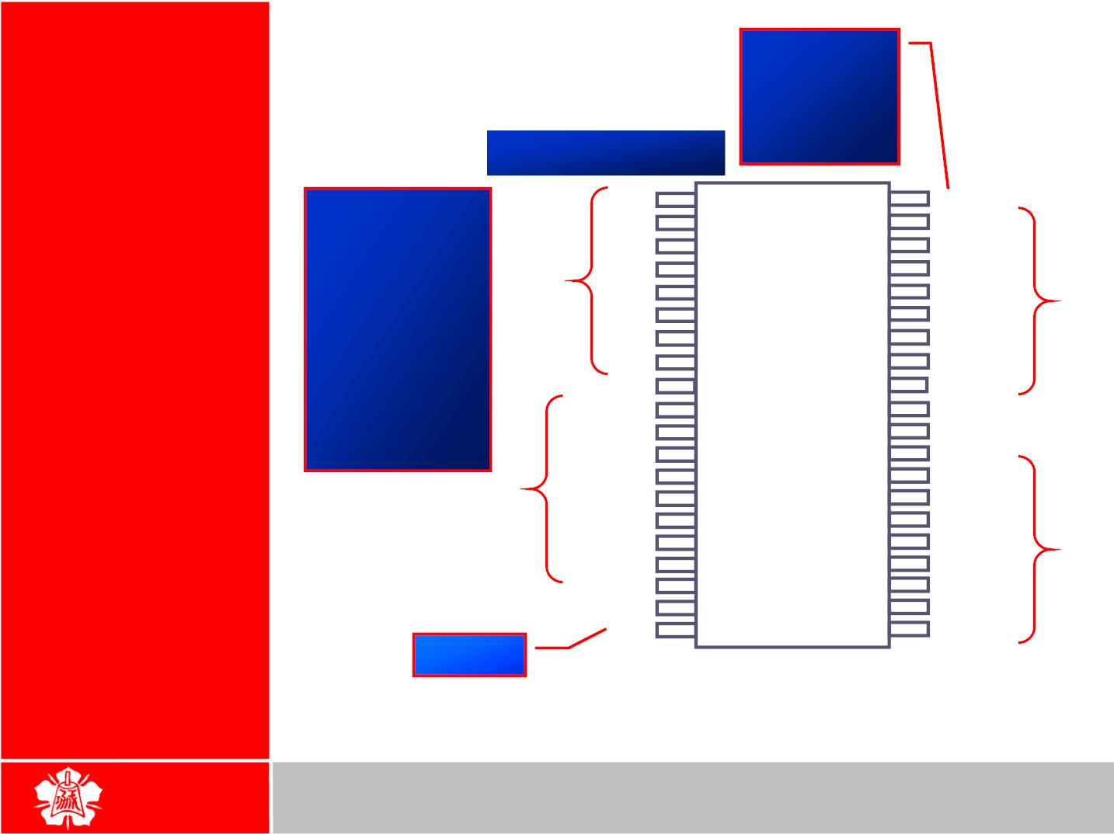
Provides
+5V supply
voltage to
the chip
I/O
PROGRAMMING
8051 Pin Diagram
A total of 32
pins are set
aside for the
four ports P0,
P1, P2, P3,
where each
port takes 8
pins
P1.0
P1.1
P1.2
P1.3
P1.4
P1.5
P1.6
P1.7
RST
1
40
39
38
37
36
35
34
Vcc
2
3
4
5
6
7
8
9
P0.0 (AD0)
P0.1 (AD1)
P0.2 (AD2)
P0.3 (AD3)
P0.4 (AD4)
P0.5 (AD5)
P0.6 (AD6)
P0.7 (AD7)
P1
P0
P2
8051
(8031)
(89420)
33
32
(RXD) P3.0
(TXD) P3.1
(-INT0) P3.2
(-INT1) P3.3
(T0) P3.4
(T1) P3.5
(-WR) P3.6
(-RD )P3.7
XTAL2
10
11
12
13
14
15
16
17
18
19
20
31
30
29
28
27
26
25
24
23
22
21
-EA/VPP
ALE/PROG
-PSEN
P3
P2.7 (A15)
P2.6 (A14)
P2.5 (A13)
P2.4 (A12)
P2.3 (A11)
P2.2 (A10)
P2.1 (A9)
P2.0 (A8)
XTAL1
GND
Grond
2

Slide 3

 The four 8-bit I/O ports P0, P1, P2 and
P3 each uses 8 pins
 All the ports upon RESET are
I/O
PROGRAMMING
I/O Port Pins configured as input, ready to be used
as input ports
¾ When the first 0 is written to a port, it
becomes an output
¾ To reconfigure it as an input, a 1 must be
P1.0
P1.1
P1.2
P1.3
P1.4
P1.5
P1.6
P1.7
RST
1
2
3
4
5
6
7
8
40
39
38
37
36
35
34
33
32
Vcc
P0.0(AD0)
P0.1(AD1)
P0.2(AD2)
P0.3(AD3)
P0.4(AD4)
P0.5(AD5)
P0.6(AD6)
P0.7(AD7)
-EA/VPP
ALE/PROG
-PSEN
sent to the port
 To use any of these ports as an input port, it
(RXD)P3.0
(TXD)P3.1
(INT0)P3.2
(INT1)P3.3
(T0)P3.4
(T1)P3.5
(WR)P3.6
(RD)P3.7
XTAL2
XTAL1
GND
⁹ 8051
31
must be programmed
10
¹¹(8031)³⁰
12
13
14
15
16
17
18
19
20
29
28
27
26
25
24
23
22
21
P2.7(A15)
P2.6(A14)
P2.5(A13)
P2.4(A12)
P2.3(A11)
P2.2(A10)
P2.1(A9)
P2.0(A8)
3

Slide 4
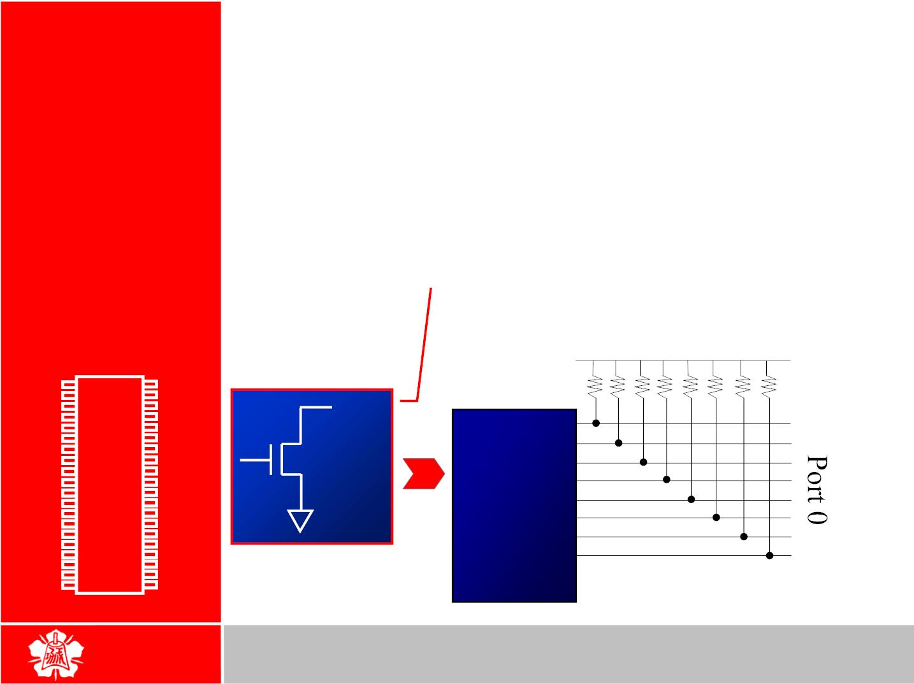
 It can be used for input or output,
each pin must be connected externally
to a 10K ohm pull-up resistor
I/O
PROGRAMMING
Port 0
¾
This is due to the fact that P0 is an open
drain, unlike P1, P2, and P3
 Open drain is a term used for MOS chips in the
same way that open collector is used for TTL
chips
Vcc
P1.0
P1.1
P1.2
P1.3
P1.4
P1.5
P1.6
P1.7
RST
1
2
3
4
5
6
7
8
40
39
38
37
36
35
34
33
32
Vcc
10 K
P0.0(AD0)
P0.1(AD1)
P0.2(AD2)
P0.3(AD3)
P0.4(AD4)
P0.5(AD5)
P0.6(AD6)
P0.7(AD7)
-EA/VPP
ALE/PROG
-PSEN
P0.X
P0.0
P0.1
P0.2
P0.3
P0.4
P0.5
P0.6
P0.7
⁹ 8051
8051
(RXD)P3.0
(TXD)P3.1
(INT0)P3.2
(INT1)P3.3
(T0)P3.4
(T1)P3.5
(WR)P3.6
(RD)P3.7
XTAL2
XTAL1
GND
10
31
¹¹(8031)³⁰
12
13
14
15
16
17
18
19
20
29
28
27
26
25
24
23
22
21
P2.7(A15)
P2.6(A14)
P2.5(A13)
P2.4(A12)
P2.3(A11)
P2.2(A10)
P2.1(A9)
P2.0(A8)
4

Slide 5
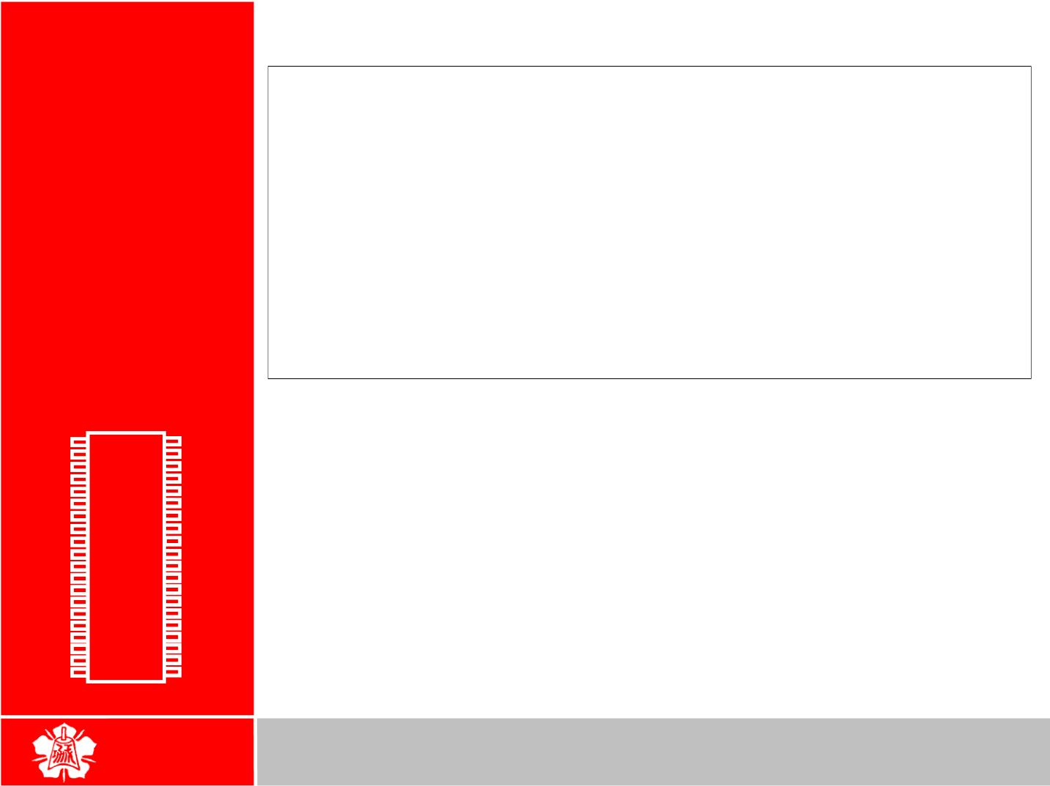
I/O
The following code will continuously send out to port 0 the
alternating value 55H and AAH
PROGRAMMING
BACK: MOV
MOV
A,#55H
P0,A
Port 0
(cont’)
ACALL DELAY
MOV
MOV
A,#0AAH
P0,A
ACALL DELAY
SJMP BACK
P1.0
P1.1
P1.2
P1.3
P1.4
P1.5
P1.6
P1.7
RST
1
2
3
4
5
6
7
8
40
39
38
37
36
35
34
33
32
Vcc
P0.0(AD0)
P0.1(AD1)
P0.2(AD2)
P0.3(AD3)
P0.4(AD4)
P0.5(AD5)
P0.6(AD6)
P0.7(AD7)
-EA/VPP
ALE/PROG
-PSEN
(RXD)P3.0
(TXD)P3.1
(INT0)P3.2
(INT1)P3.3
(T0)P3.4
(T1)P3.5
(WR)P3.6
(RD)P3.7
XTAL2
XTAL1
GND
⁹ 8051
31
10
¹¹(8031)³⁰
12
13
14
15
16
17
18
19
20
29
28
27
26
25
24
23
22
21
P2.7(A15)
P2.6(A14)
P2.5(A13)
P2.4(A12)
P2.3(A11)
P2.2(A10)
P2.1(A9)
P2.0(A8)
5

Slide 6
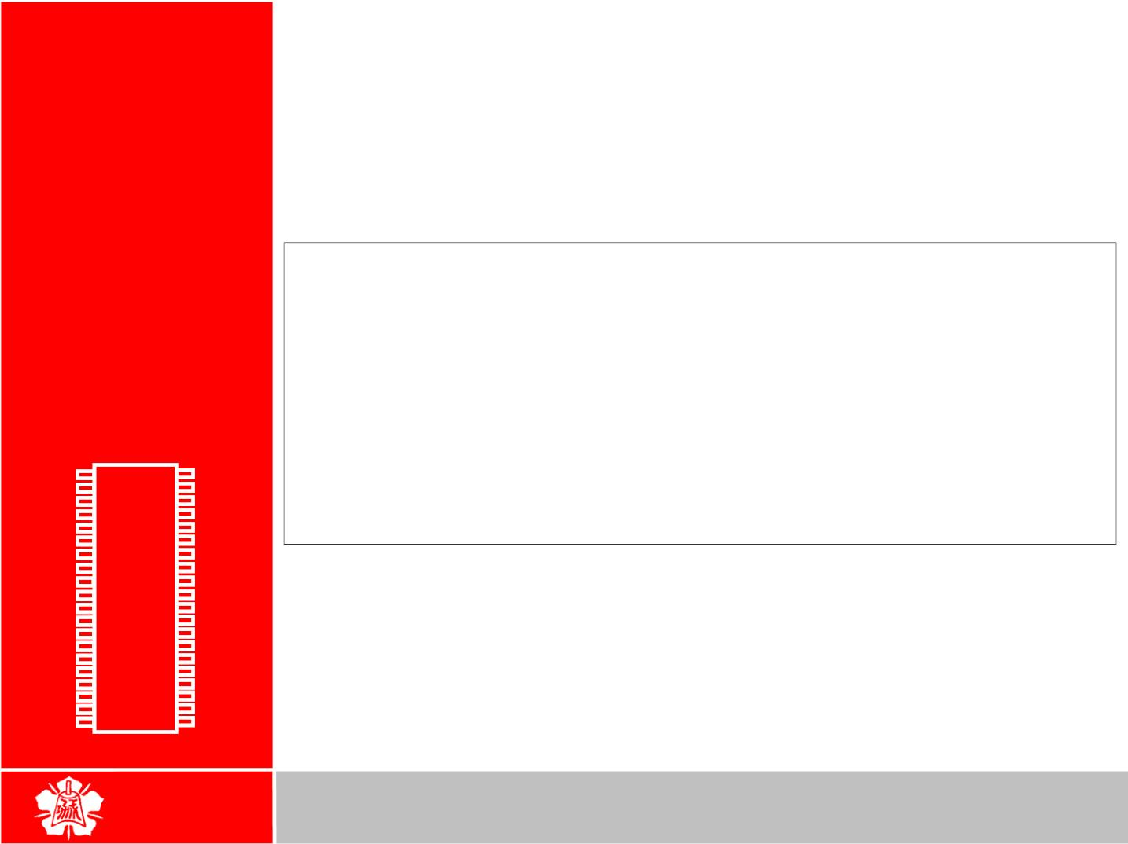
 In order to make port 0 an input, the
port must be programmed by writing 1
to all the bits
I/O
PROGRAMMING
Port 0 as Input
Port 0 is configured first as an input port by writing 1s to it, and then
data is received from that port and sent to P1
MOV
MOV
A,#0FFH
P0,A
;A=FF hex
;make P0 an i/p port
;by writing it all 1s
;get data from P0
;send it to port 1
;keep doing it
BACK: MOV
MOV
A,P0
P1,A
P1.0
P1.1
P1.2
P1.3
P1.4
P1.5
P1.6
P1.7
RST
1
2
3
4
5
6
7
8
40
39
38
37
36
35
34
33
32
Vcc
P0.0(AD0)
P0.1(AD1)
P0.2(AD2)
P0.3(AD3)
P0.4(AD4)
P0.5(AD5)
P0.6(AD6)
P0.7(AD7)
-EA/VPP
ALE/PROG
-PSEN
SJMP BACK
(RXD)P3.0
(TXD)P3.1
(INT0)P3.2
(INT1)P3.3
(T0)P3.4
(T1)P3.5
(WR)P3.6
(RD)P3.7
XTAL2
XTAL1
GND
⁹ 8051
31
10
¹¹(8031)³⁰
12
13
14
15
16
17
18
19
20
29
28
27
26
25
24
23
22
21
P2.7(A15)
P2.6(A14)
P2.5(A13)
P2.4(A12)
P2.3(A11)
P2.2(A10)
P2.1(A9)
P2.0(A8)
6

Slide 7
 Port 0 is also designated as AD0-AD7,
allowing it to be used for both address
and data
I/O
PROGRAMMING
Dual Role of
Port 0
¾
When connecting an 8051/31 to an
external memory, port 0 provides both
address and data
P1.0
P1.1
P1.2
P1.3
P1.4
P1.5
P1.6
P1.7
RST
1
2
3
4
5
6
7
8
40
39
38
37
36
35
34
33
32
Vcc
P0.0(AD0)
P0.1(AD1)
P0.2(AD2)
P0.3(AD3)
P0.4(AD4)
P0.5(AD5)
P0.6(AD6)
P0.7(AD7)
-EA/VPP
ALE/PROG
-PSEN
(RXD)P3.0
(TXD)P3.1
(INT0)P3.2
(INT1)P3.3
(T0)P3.4
(T1)P3.5
(WR)P3.6
(RD)P3.7
XTAL2
XTAL1
GND
⁹ 8051
31
10
¹¹(8031)³⁰
12
13
14
15
16
17
18
19
20
29
28
27
26
25
24
23
22
21
P2.7(A15)
P2.6(A14)
P2.5(A13)
P2.4(A12)
P2.3(A11)
P2.2(A10)
P2.1(A9)
P2.0(A8)
7

Slide 8

 Port 1 can be used as input or output
I/O
PROGRAMMING
¾ In contrast to port 0, this port does not
need any pull-up resistors since it already
has pull-up resistors internally
Port 1
¾ Upon reset, port 1 is configured as an
input port
The following code will continuously send out to port 0 the
alternating value 55H and AAH
P1.0
P1.1
P1.2
P1.3
P1.4
P1.5
P1.6
P1.7
RST
1
2
3
4
5
6
7
8
40
Vcc
MOV
BACK: MOV
A,#55H
P1,A
39
38
37
36
35
34
33
32
P0.0(AD0)
P0.1(AD1)
P0.2(AD2)
P0.3(AD3)
P0.4(AD4)
P0.5(AD5)
P0.6(AD6)
P0.7(AD7)
-EA/VPP
ALE/PROG
-PSEN
ACALL DELAY
CPL
SJMP BACK
⁹ 8051
31
A
(RXD)P3.0
(TXD)P3.1
(INT0)P3.2
(INT1)P3.3
(T0)P3.4
(T1)P3.5
(WR)P3.6
(RD)P3.7
XTAL2
XTAL1
GND
10
¹¹(8031)³⁰
12
13
14
15
16
17
18
19
20
29
28
27
26
25
24
23
22
21
P2.7(A15)
P2.6(A14)
P2.5(A13)
P2.4(A12)
P2.3(A11)
P2.2(A10)
P2.1(A9)
P2.0(A8)
8

Slide 9

 To make port 1 an input port, it must
be programmed as such by writing 1
to all its bits
I/O
PROGRAMMING
Port 1 as Input
Port 1 is configured first as an input port by writing 1s to it, then data
is received from that port and saved in R7 and R5
MOV
MOV
A,#0FFH
P1,A
;A=FF hex
;make P1 an input port
;by writing it all 1s
;get data from P1
;save it to in reg R7
;wait
MOV
MOV
ACALL DELAY
A,P1
R7,A
P1.0
P1.1
P1.2
P1.3
P1.4
P1.5
P1.6
P1.7
RST
1
2
3
4
5
6
7
8
40
Vcc
39
38
37
36
35
34
33
32
P0.0(AD0)
P0.1(AD1)
P0.2(AD2)
P0.3(AD3)
P0.4(AD4)
P0.5(AD5)
P0.6(AD6)
P0.7(AD7)
-EA/VPP
ALE/PROG
-PSEN
MOV
MOV
A,P1
R5,A
;another data from P1
;save it to in reg R5
(RXD)P3.0
(TXD)P3.1
(INT0)P3.2
(INT1)P3.3
(T0)P3.4
(T1)P3.5
(WR)P3.6
(RD)P3.7
XTAL2
XTAL1
GND
⁹ 8051
31
10
¹¹(8031)³⁰
12
13
14
15
16
17
18
19
20
29
28
27
26
25
24
23
22
21
P2.7(A15)
P2.6(A14)
P2.5(A13)
P2.4(A12)
P2.3(A11)
P2.2(A10)
P2.1(A9)
P2.0(A8)
9

Slide 10
 Port 2 can be used as input or output
I/O
PROGRAMMING
¾ Just like P1, port 2 does not need any pull-
up resistors since it already has pull-up
resistors internally
Port 2
¾ Upon reset, port 2 is configured as an input
port
P1.0
P1.1
P1.2
P1.3
P1.4
P1.5
P1.6
P1.7
RST
1
2
3
4
5
6
7
8
40
39
38
37
36
35
34
33
32
Vcc
P0.0(AD0)
P0.1(AD1)
P0.2(AD2)
P0.3(AD3)
P0.4(AD4)
P0.5(AD5)
P0.6(AD6)
P0.7(AD7)
-EA/VPP
ALE/PROG
-PSEN
(RXD)P3.0
(TXD)P3.1
(INT0)P3.2
(INT1)P3.3
(T0)P3.4
(T1)P3.5
(WR)P3.6
(RD)P3.7
XTAL2
XTAL1
GND
⁹ 8051
31
10
¹¹(8031)³⁰
12
13
14
15
16
17
18
19
20
29
28
27
26
25
24
23
22
21
P2.7(A15)
P2.6(A14)
P2.5(A13)
P2.4(A12)
P2.3(A11)
P2.2(A10)
P2.1(A9)
P2.0(A8)
10

Slide 11
 To make port 2 an input port, it must
be programmed as such by writing 1 to
all its bits
I/O
PROGRAMMING
Port 2 as Input In many 8051-based system, P2 is used

or Dual Role
as simple I/O
 In 8031-based systems, port 2 must be
used along with P0 to provide the 16-
bit address for the external memory
P1.0
P1.1
P1.2
P1.3
P1.4
P1.5
P1.6
P1.7
RST
1
2
3
4
5
6
7
8
40
39
38
37
36
35
34
33
32
Vcc
P0.0(AD0)
P0.1(AD1)
P0.2(AD2)
P0.3(AD3)
P0.4(AD4)
P0.5(AD5)
P0.6(AD6)
P0.7(AD7)
-EA/VPP
ALE/PROG
-PSEN
¾ Port 2 is also designated as A8 – A15,
indicating its dual function
¾ Port 0 provides the lower 8 bits via A0 – A7
(RXD)P3.0
(TXD)P3.1
(INT0)P3.2
(INT1)P3.3
(T0)P3.4
(T1)P3.5
(WR)P3.6
(RD)P3.7
XTAL2
XTAL1
GND
⁹ 8051
31
10
¹¹(8031)³⁰
12
13
14
15
16
17
18
19
20
29
28
27
26
25
24
23
22
21
P2.7(A15)
P2.6(A14)
P2.5(A13)
P2.4(A12)
P2.3(A11)
P2.2(A10)
P2.1(A9)
P2.0(A8)
11

Slide 12
 Port 3 can be used as input or output
I/O
PROGRAMMING
¾ Port 3 does not need any pull-up resistors
¾ Port 3 is configured as an input port upon
reset, this is not the way it is most
commonly used
Port 3
P1.0
P1.1
P1.2
P1.3
P1.4
P1.5
P1.6
P1.7
RST
1
2
3
4
5
6
7
8
40
39
38
37
36
35
34
33
32
Vcc
P0.0(AD0)
P0.1(AD1)
P0.2(AD2)
P0.3(AD3)
P0.4(AD4)
P0.5(AD5)
P0.6(AD6)
P0.7(AD7)
-EA/VPP
ALE/PROG
-PSEN
(RXD)P3.0
(TXD)P3.1
(INT0)P3.2
(INT1)P3.3
(T0)P3.4
(T1)P3.5
(WR)P3.6
(RD)P3.7
XTAL2
XTAL1
GND
⁹ 8051
31
10
¹¹(8031)³⁰
12
13
14
15
16
17
18
19
20
29
28
27
26
25
24
23
22
21
P2.7(A15)
P2.6(A14)
P2.5(A13)
P2.4(A12)
P2.3(A11)
P2.2(A10)
P2.1(A9)
P2.0(A8)
12

Slide 13
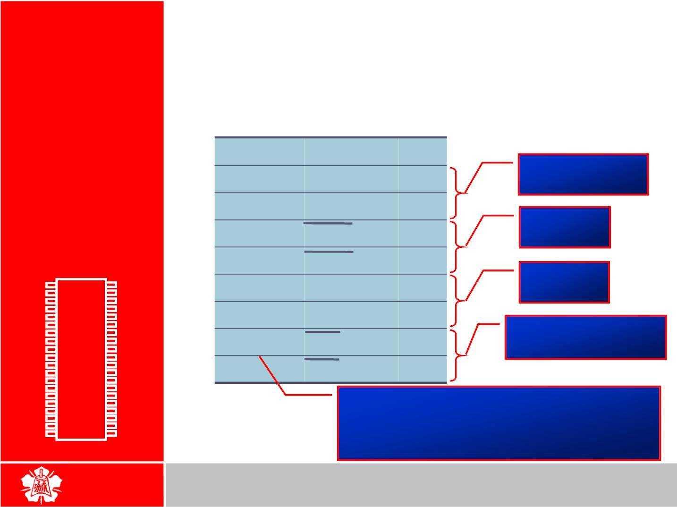
 Port 3 has the additional function of
providing some extremely important
signals
I/O
PROGRAMMING
Port 3
(cont’)
P3 Bit
P3.0
P3.1
P3.2
P3.3
P3.4
P3.5
P3.6
P3.7
Function Pin
Serial
RxD
TxD
INT0
INT1
T0
10
11
12
13
14
15
16
17
communications
External
interrupts
P1.0
P1.1
P1.2
P1.3
P1.4
P1.5
P1.6
P1.7
RST
1
2
3
4
5
6
7
8
40
39
38
37
36
35
34
33
32
Vcc
Timers
P0.0(AD0)
P0.1(AD1)
P0.2(AD2)
P0.3(AD3)
P0.4(AD4)
P0.5(AD5)
P0.6(AD6)
P0.7(AD7)
-EA/VPP
ALE/PROG
-PSEN
T1
Read/Write signals
of external memories
WR
RD
(RXD)P3.0
(TXD)P3.1
(INT0)P3.2
(INT1)P3.3
(T0)P3.4
(T1)P3.5
(WR)P3.6
(RD)P3.7
XTAL2
XTAL1
GND
⁹ 8051
31
10
¹¹(8031)³⁰
12
13
14
15
16
17
18
19
20
29
28
27
26
25
24
23
22
21
P2.7(A15)
P2.6(A14)
P2.5(A13)
P2.4(A12)
P2.3(A11)
P2.2(A10)
P2.1(A9)
P2.0(A8)
In systems based on 8751, 89C51 or
DS89C4x0, pins 3.6 and 3.7 are used for I/O
while the rest of the pins in port 3 are
normally used in the alternate function role
13

Slide 14
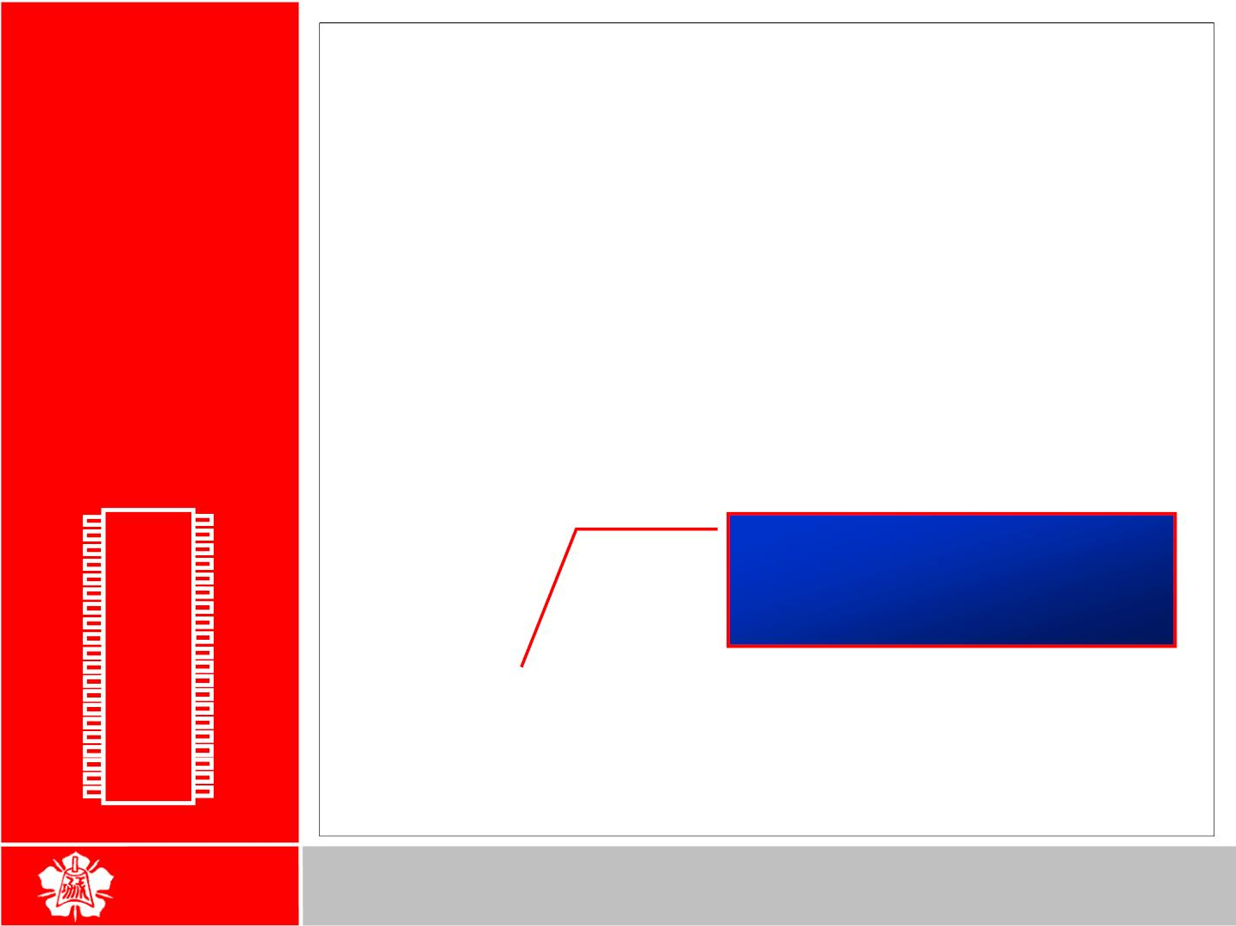
Write a program for the DS89C420 to toggle all the bits of P0, P1,
and P2 every 1/4 of a second
I/O
ORG
BACK: MOV
MOV
0
PROGRAMMING
A,#55H
P0,A
P1,A
P2,A
MOV
MOV
Port 3
(cont’)
ACALL QSDELAY
;Quarter of a second
MOV
MOV
MOV
MOV
A,#0AAH
P0,A
P1,A
P2,A
ACALL QSDELAY
SJMP BACK
P1.0
P1.1
P1.2
P1.3
P1.4
P1.5
P1.6
P1.7
RST
1
2
3
4
5
6
7
8
40
39
38
37
36
35
34
33
32
Vcc
QSDELAY:
MOV
P0.0(AD0)
P0.1(AD1)
P0.2(AD2)
P0.3(AD3)
P0.4(AD4)
P0.5(AD5)
P0.6(AD6)
P0.7(AD7)
-EA/VPP
ALE/PROG
-PSEN
Delay
R5,#11
×
×
×
×
= 11 248 255 4 MC 90 ns
H3:
H2:
H1:
MOV
MOV
R4,#248 = 250,430 µs
⁹ 8051
R3,#255
(RXD)P3.0
(TXD)P3.1
(INT0)P3.2
(INT1)P3.3
(T0)P3.4
(T1)P3.5
(WR)P3.6
(RD)P3.7
XTAL2
XTAL1
GND
10
31
¹¹(8031)³⁰
DJNZ R3,H1
DJNZ R4,H2
DJNZ R5,H3
RET
;4 MC for DS89C4x0
12
13
14
15
16
17
18
19
20
29
28
27
26
25
24
23
22
21
P2.7(A15)
P2.6(A14)
P2.5(A13)
P2.4(A12)
P2.3(A11)
P2.2(A10)
P2.1(A9)
P2.0(A8)
END
14

Slide 15

The entire 8 bits of Port 1 are accessed
I/O
BACK: MOV
MOV
A,#55H
P1,A
PROGRAMMING
ACALL DELAY
MOV
MOV
A,#0AAH
P1,A
Different ways
of Accessing
Entire 8 Bits
ACALL DELAY
SJMP BACK
Rewrite the code in a more efficient manner by accessing the port
directly without going through the accumulator
BACK: MOV
P1,#55H
ACALL DELAY
MOV
P1,#0AAH
ACALL DELAY
SJMP BACK
Another way of doing the same thing
MOV
A,#55H
P1,A
BACK: MOV
ACALL DELAY
CPL
A
SJMP BACK
15

Slide 16
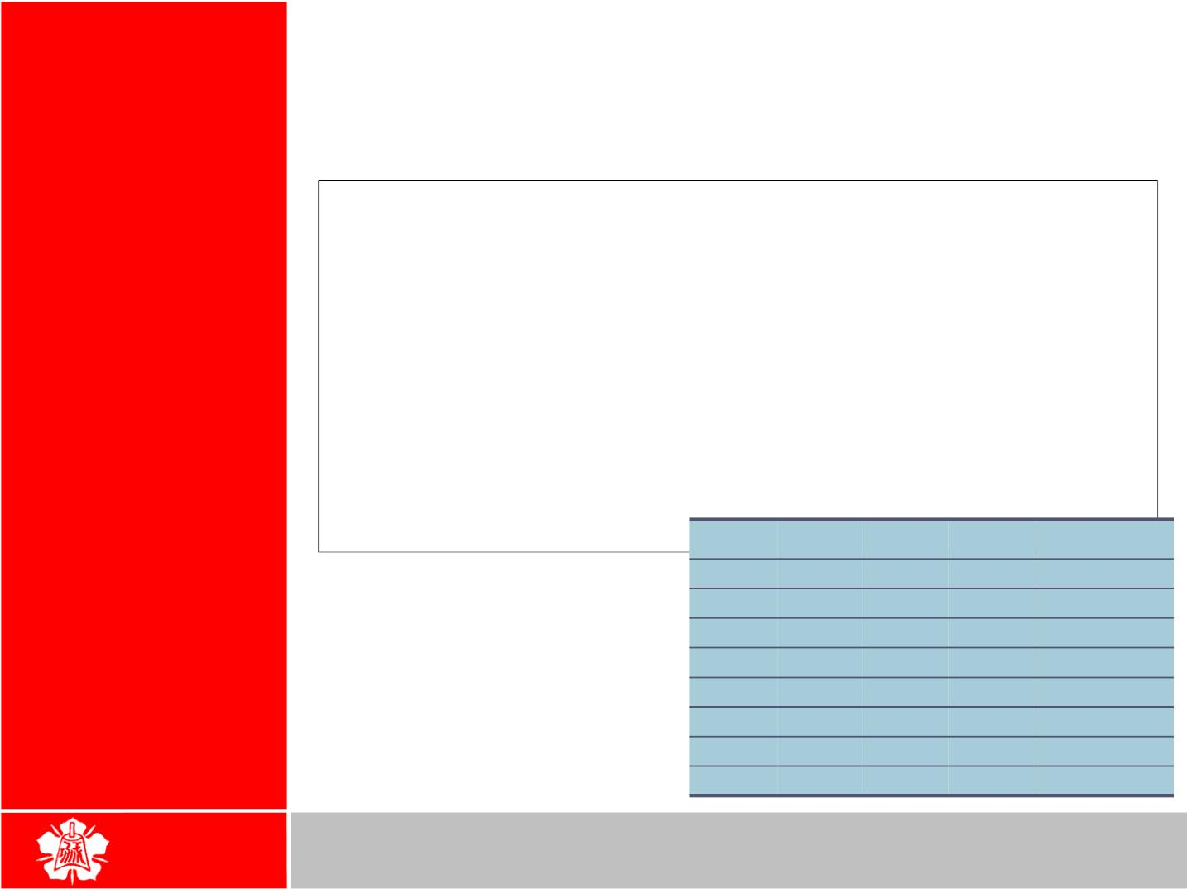
 Sometimes we need to access only 1
I/O BIT
MANIPULATION
or 2 bits of the port
PROGRAMMING BACK: CPL
P1.2
ACALL DELAY
SJMP BACK
;complement P1.2
I/O Ports
and Bit
Addressability
;another variation of the above program
AGAIN: SETB P1.2
ACALL DELAY
;set only P1.2
CLR
P1.2
;clear only P1.2
ACALL DELAY
SJMP AGAIN
P0
P1
P2
P3
Port Bit
D0
P0.0
P0.1
P0.2
P0.3
P0.4
P0.5
P0.6
P0.7
P1.0
P1.1
P1.2
P1.3
P1.4
P1.5
P1.6
P1.7
P2.0
P2.1
P2.2
P2.3
P2.4
P2.5
P2.6
P2.7
P3.0
P3.1
P3.2
P3.3
P3.4
P3.5
P3.6
P3.7
D1
D2
D3
D4
D5
D6
D7
16

Slide 17
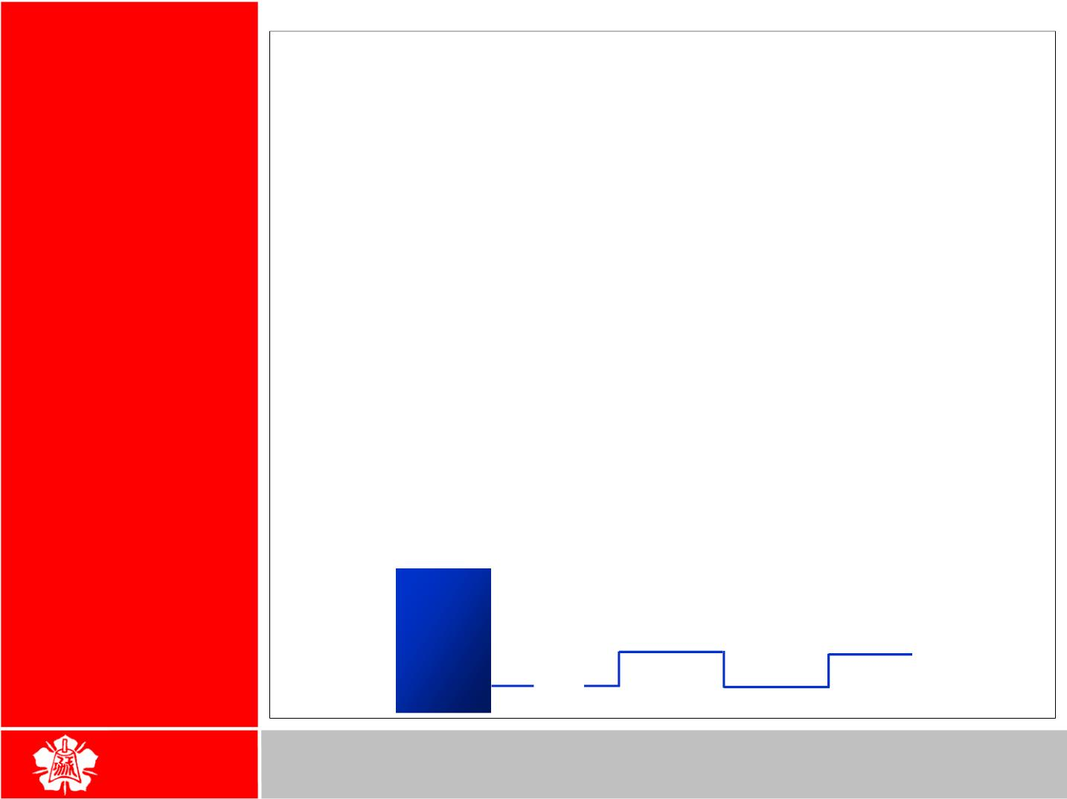
Example 4-2
I/O BIT
MANIPULATION
PROGRAMMING
Write the following programs.
Create a square wave of 50% duty cycle on bit 0 of port 1.
Solution:
The 50% duty cycle means that the “on” and “off” state (or the high
and low portion of the pulse) have the same length. Therefore,
we toggle P1.0 with a time delay in between each state.
I/O Ports
and Bit
Addressability
HERE: SETB P1.0 ;set to high bit 0 of port 1
LCALL DELAY ;call the delay subroutine
CLR
P1.0 ;P1.0=0
(cont’)
LCALL DELAY
SJMP HERE ;keep doing it
Another way to write the above program is:
HERE: CPL
P1.0 ;set to high bit 0 of port 1
LCALL DELAY ;call the delay subroutine
SJMP HERE ;keep doing it
8051
P1.0
17

